Slide 1
Code Crushers

Slide 2
THIS IS OUR TEAM.
Mayur Prabhakar Sangale
Prasad Satish Deshpande
Divya Dipak Kharche

Slide 3
PURPOSE
Develop a fighting game Arcade Mania having two-players and consisting of 6 characters to choose from.
Player need to login & validate first in order to play the game.
Player can select his favorite character and playing gets more exciting.
You want to play? Each character has special ability as well, awesome right?.
Enjoy gaming!!

Slide 4



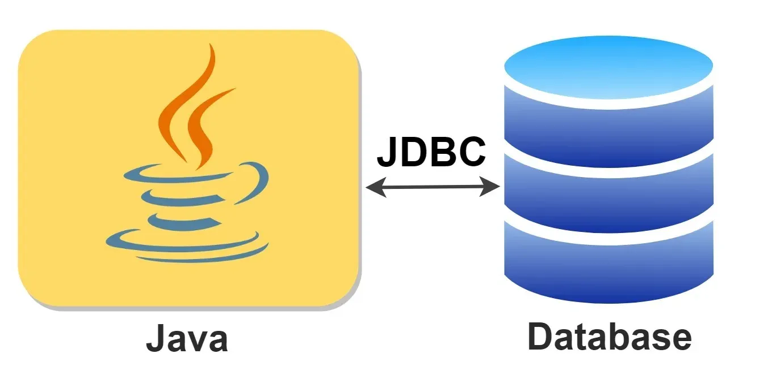


TECH STACK
Scene Builder

Slide 5
Features
1 | Authentication
2 | Swap players
4 | Media
5 | Unique Characters
Sign In
Verify user details in database
Change character when game starts
Character change while playing
3 | User experience
Added background effect
For better UI presentation
Sound effects to make playing interesting
Added six unique characters
Selective weapons for each character

Slide 6
System Design
There are primarily 4 screens used in the project
Login, Home, Game and End
There are 4 controller classes used to render these screens: LoginController, HomeController, GameController, EndController

Slide 7
Implementation
Database Connection:
public void initialize() {
try {
Class.forName("com.mysql.jdbc.Driver");
String url = "jdbc:mysql://localhost:3306/Mayur";
String user = "root";
String password = "mayur";
conn = DriverManager.getConnection(url, user, password);
} catch (ClassNotFoundException e) {
e.printStackTrace();
} catch (SQLException e) {
e.printStackTrace();
}
}

Slide 8
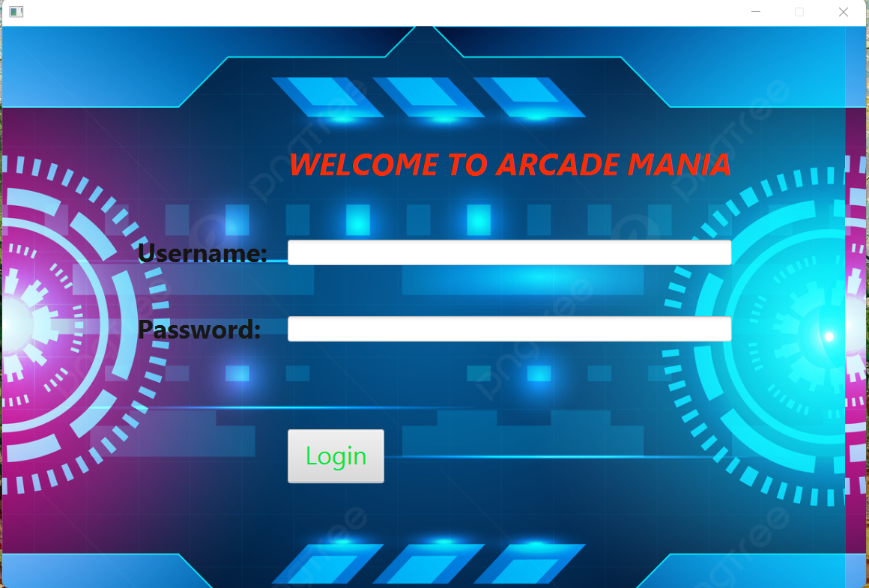
LOGIN PAGE

Slide 9
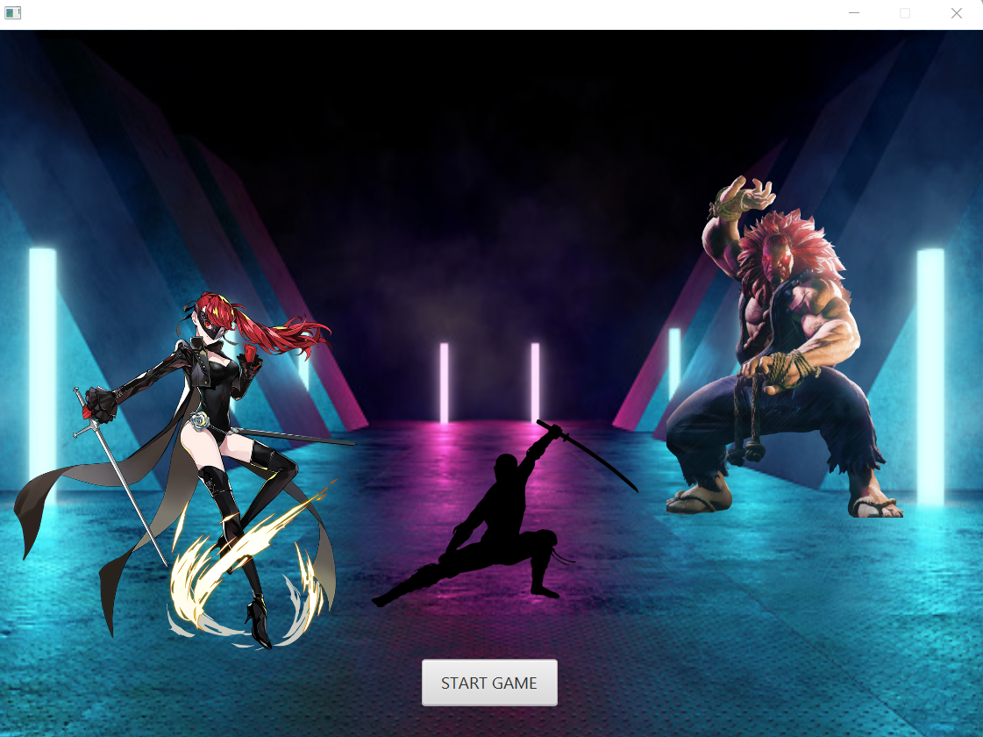
LANDING PAGE

Slide 10
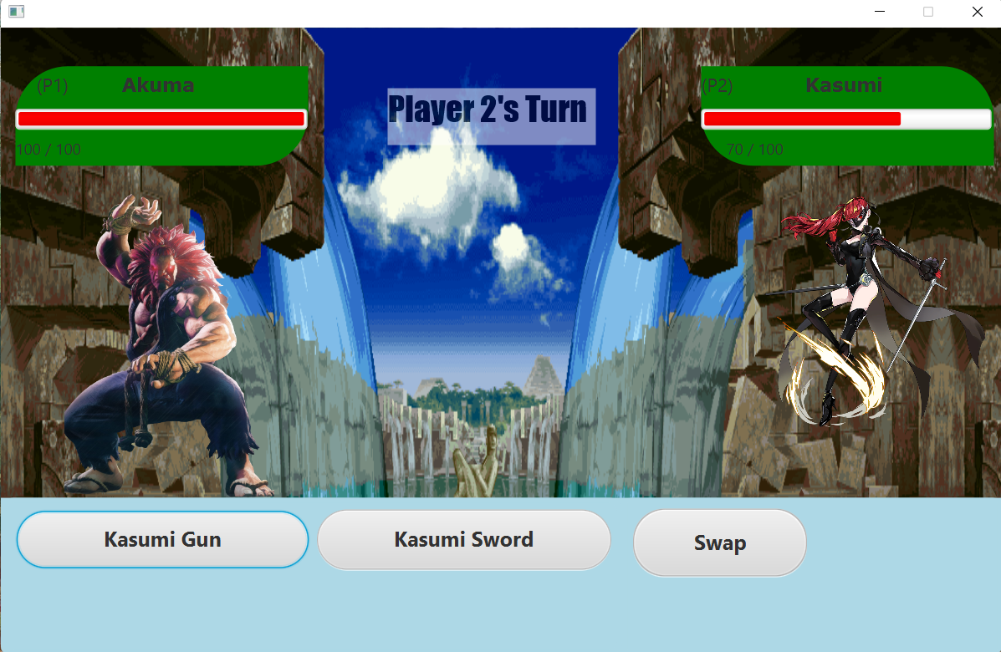
GAME PAGE

Slide 11
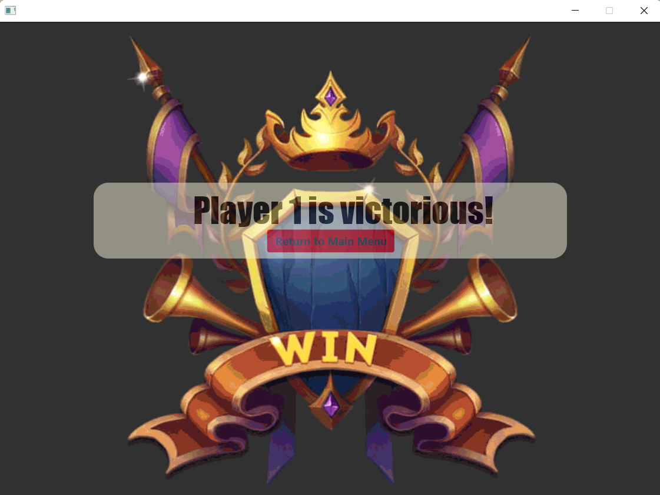
WINNER SCREEN

Slide 12
Challenges Faced
Game flow from one screen to another screen
Connective database to project
Calculate player damage

Slide 13
Conclusion & Future Work
The game is light-weight and doesn’t require much advanced system to run it
The game doesn’t require much of a learning to play it and is easy to operate
The game can be made more advanced by adding a 2v2 mode

Slide 14
Contributions
Mayur
Divya
Prasad
Authentication
JDBC connectivity
Swap Players
Player Damage
Background effects
Media & sound addition
Unique Characters
Dialog box
Health bar
Selective weapons
Animation

Slide 15

References
JavaFX playing audio - javatpoint. www.javatpoint.com. (n.d.). Retrieved April 18, 2023, from https://www.javatpoint.com/javafx-playing-audio
Transition in JavaFX. Transition (JavaFX 2.2). (2013, December 9). Retrieved April 18, 2023, from https://docs.oracle.com/javafx/2/api/javafx/animation/Transition.html
JavaFX Tutorial – javatpoint. www.javatpoint.com. Retrieved April 18, 2023, from https://www.javatpoint.com/javafx-tutorial
JavaFX – Animations - tutorialspoint. www.tutorialspoint.com. Retrieved April 18, 2023, from https://www.tutorialspoint.com/javafx/javafx_animations.htm

Slide 16
THANK YOU!

Slide 17
DEMO

